Slide 1
Horizon Enterprise Aircraft Assessment Insights

Slide 2

Presentation Overview
Overview
Business Understanding
Data Understanding
Data Analysis
Recommendations
Next Steps

Slide 3
Overview
This project analyzes aviation accidents since 1962, focusing on civil aviation incidents in the U.S., its territories, and international waters.
The insights will help Horizon Enterprise identify safe, low-risk aircraft for Horizon Ventures, minimize operational risks, enhance reputation, and support safer fleet acquisitions for expansion into the aviation industry.

Slide 4
Business Understanding
Horizon Enterprises is seeking to expand into the Aviation and Aerospace Industry, specifically the Aircraft Operations and Fleet management as a means of diversifying their portfolio. The goal is to ensure business continuity, minimize financial risks, and optimize fleet performance.

Slide 5
Data Understanding

Slide 6
Avaition Datasets
Aviation Data
The NTSB aviation accident database contains information from 1962 and later about civil aviation accidents and selected incidents within the United States, its territories and possessions, and in international waters.
US State Codes
Contains the US State name and the abbreviation of them

Slide 7
Aviation Dataset Columns
Categorical Data
Numerical Data
Number of Engines
Total Fatal Injuries
Total Serious Injuries
Total Minor Injuries
Total Uninjured
Event Id
Investigation Type
Accident Number
Event Date
Location
Country
Latitude
Longitude
Airport Code
Airport Name
Injury Severity
Aircraft damage
Aircraft Category
Registration Number
Make
Model
Amateur Built
Engine Type
FAR Description
Schedule
Purpose of flight
Air carrier
Weather Condition
Broad phase of flight
Report Status
Publication Date

Slide 8
Data Analysis

Slide 9
KEY STEPS
Data Prepration and Cleaning
Feature Selection and Engineering
Analyse Data
1
3
5
2
4
6
Merging Datasets
Visualize Data
Generate Insights And Recommendations

Slide 10
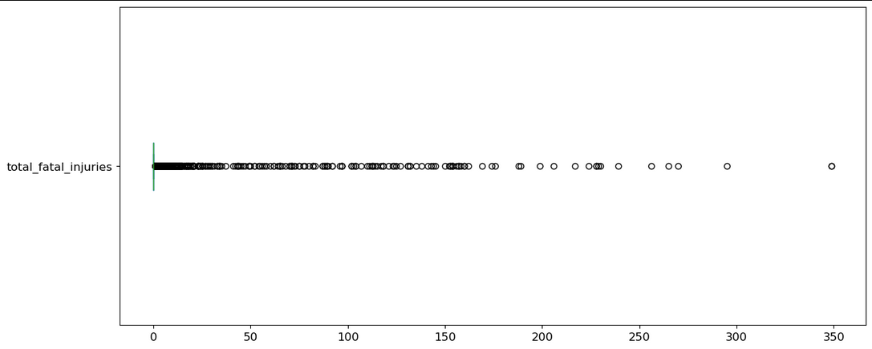
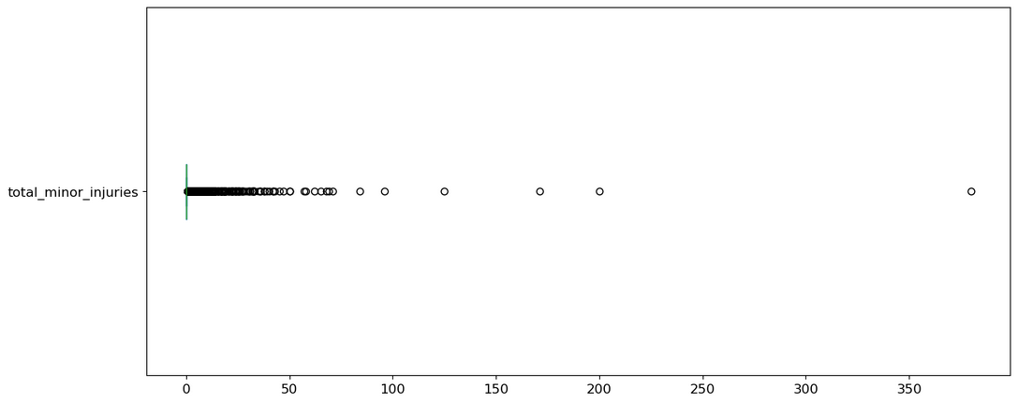
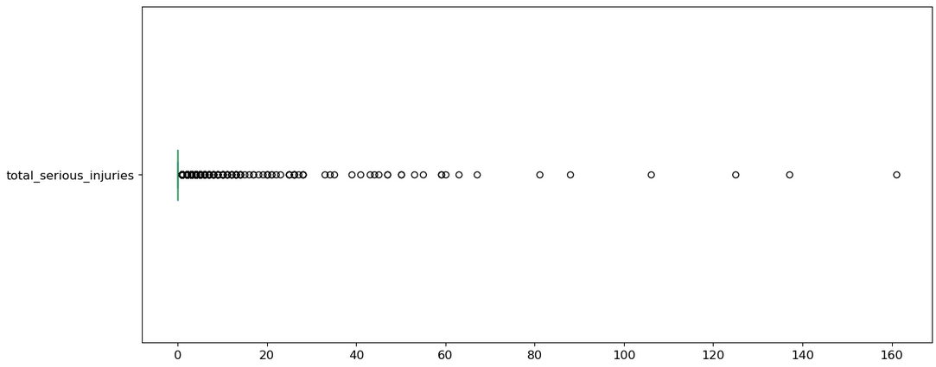
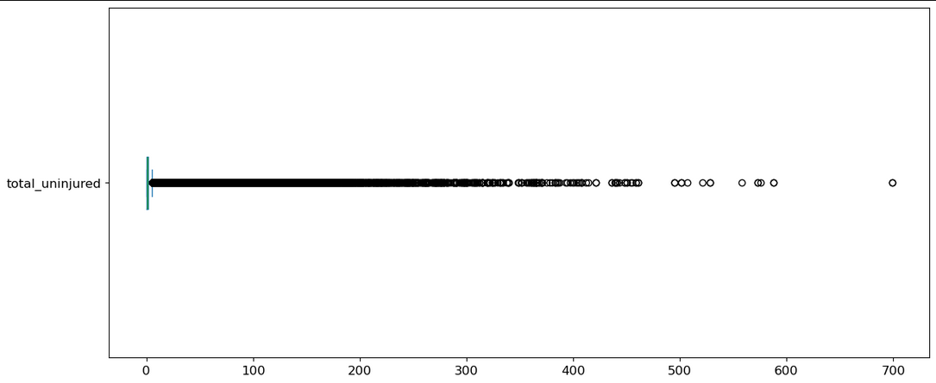
Filling Missing Values

Slide 11

Selected Variables
Event id
Investigation type
Event date
location
country
Injury severity
Aircraft damage
Aircraft category
Make
Model
Amateur built
Number of engines
Engine type
Purpose of flight
Total fatal injuries
Total serious injuries
Total minor injuries
Total uninjured
Weather condition
Broad phase of flight

Slide 12
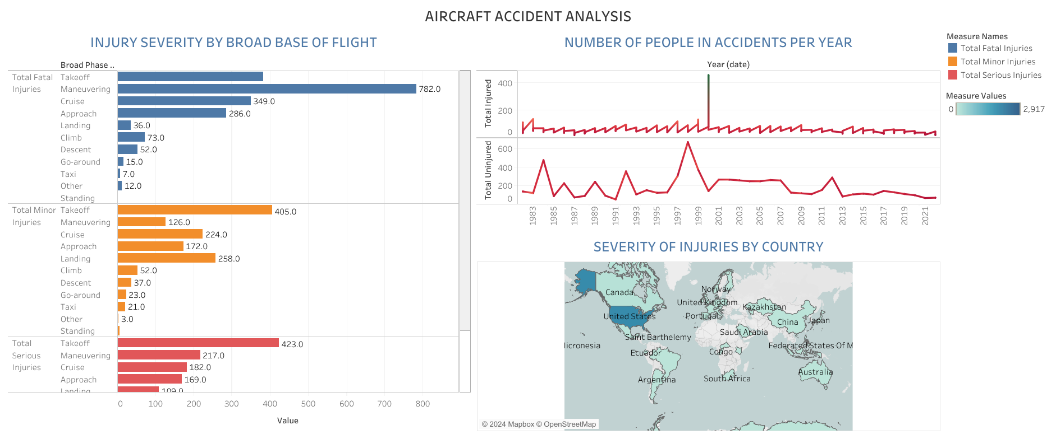
Aircraft Accident Analysis

Slide 13
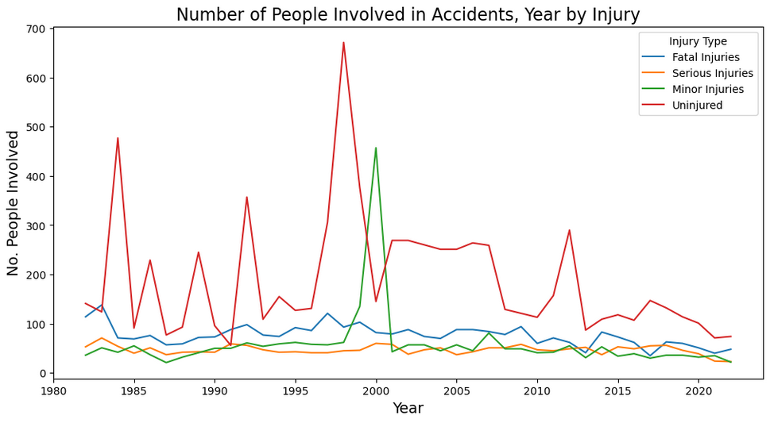
People Involved in Accidents, Year by Injury

Slide 14
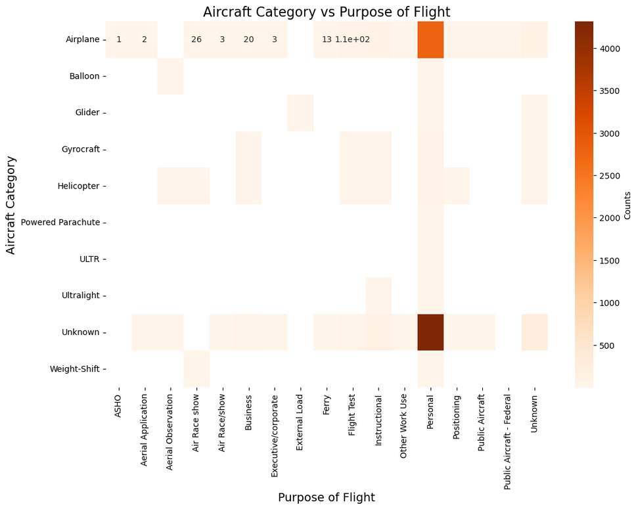
Aircraft Category vs Flight Purpose

Slide 15
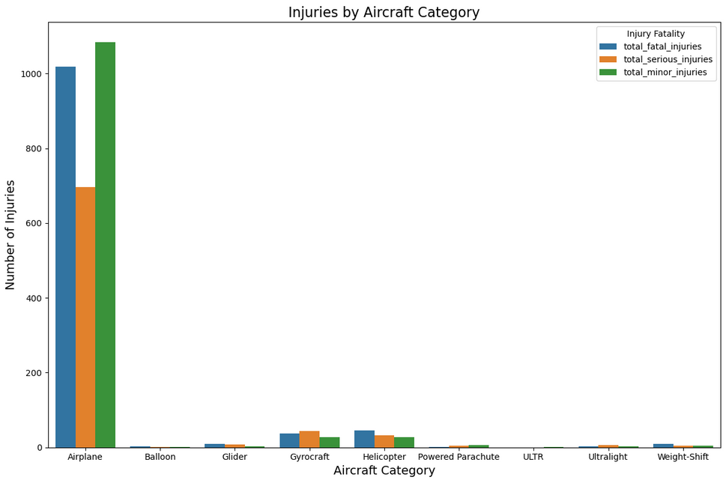
Injuries By Aircraft Category

Slide 16
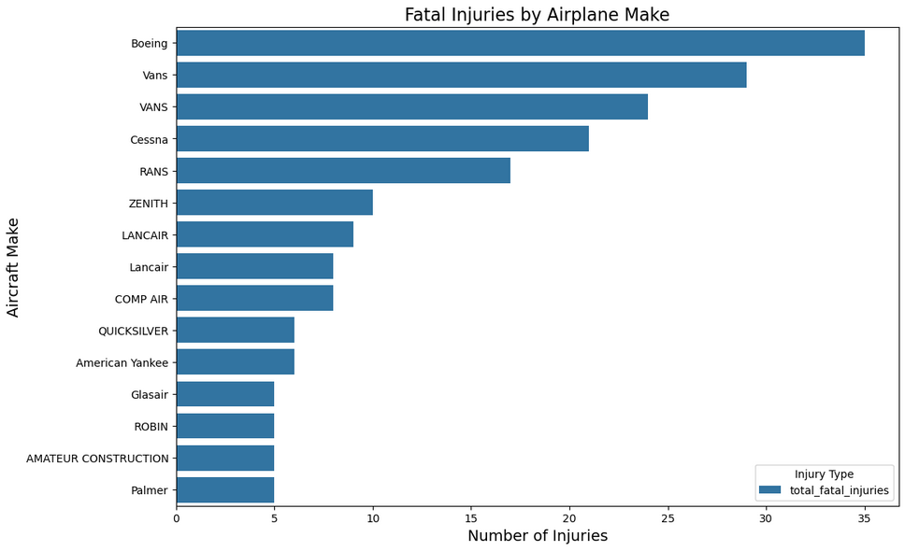
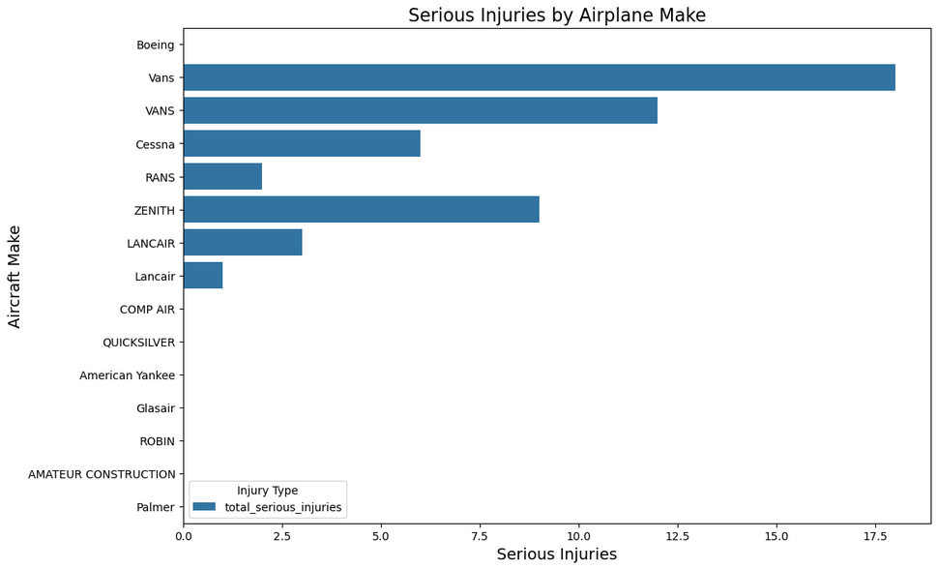
Injuries by Airplane Make

Slide 17
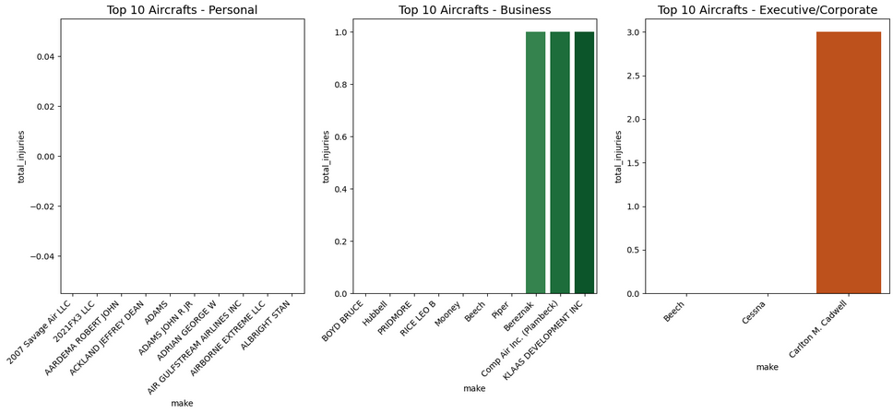
Aircraft makes & purpose of flight against with least injuries.

Slide 18

Recommendations & Next Steps.

Slide 19
Recommendations
Horizon Enterprise should prioritize airplanes, as they dominate the dataset in frequency and relevance.
For Executive/Corporate flights, the Beech 18 and Cessna stand out with the lowest accident rates and high frequency.
For Business flights, the safest and most common makes include BOYD BRUCE, Hubbell, PRIDMORE, RICE LEO B, Mooney, Beech, Piper, Bereznak, Comp Air Inc. (Plambeck), and KLAAS DEVELOPMENT INC.
For Personal flights, the least injury-prone and widely used makes are 2007 Savage Air LLC, 2021FX3 LLC, 5 RIVERS LLC, 781569 INC, AARDEMA ROBERT JOHN, ABBETT GERRY, ABBEY VICTOR, ACKLAND JEFFREY DEAN, ACRO, and ADAMS.
Next Steps
More data could enable to make more informed choices especially with regards to
Total Cost of Purchasing and Operating the Aircraft
Number of Passengers it Carries: Additional data on the seating capacity and passenger demand

Slide 20

THANKS!
Any questions?
You can find me at
@JohnMugambi - LinkedIn
John.mugambi@student.moringaschool.com

